Slide 1
Iris Specie Classification
By Chinwe Ofoegbu

Slide 2
Abstract
Iris is a flower several species. We have a database of 3 species with its 4 characteristics. This project analyzed the characteristics to predict the classification of Iris species using the K-Nearest Neighbor(KNN) model, Decision Trees and Support Vector Machines(SVM). Decision Tree model had the highest accuracy (97%) and KNN and SVM both had an accuracy of (93%)

Slide 3
Motivation
The project motivation is to help botainist know the Specie of an Iris from it’s properties. It will save time and resources with the findings and will reveal the best model to use for predicting Iris Species.

Slide 4
Dataset(s)
Iris dataset from UCI database is being used. It has 150 entries that specify the 'Id', 'SepalLengthCm', 'SepalWidthCm', 'PetalLengthCm', 'PetalWidthCm', 'Species'

Slide 5
Data Preparation and Cleaning
The database is clean and no alterations were made

Slide 6
Research Question(s)
The project tends to :
- Use any 3 scikit-learn models on this dataset to predict the specie classification
- Compare results
- Print the best one

Slide 7
Methods
The three models being used are:
KNN: classifys sample by looking at it’s closest neighbors
Decision Trees: uses a tree-like structure to capture multiple classification decision paths
Support Vector Machines(SVM) : is a supervised algoritm that classifies cases by finding a seperator

Slide 8
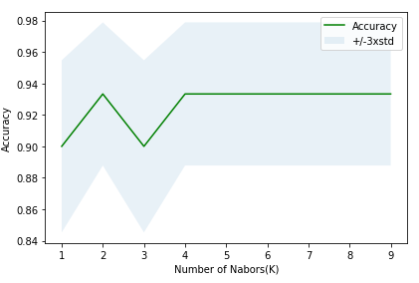
Findings(KNN model)
K =2 was used for the analysis based on this algorithm that shows k=2 having the highest accuracy.

Slide 9
Findings(KNN model)
Accuracy of the model using the metrics accuracy score()
= 93.33%

Slide 10
Findings(Decision Tree)
Accuracy of the model using the metrics accuracy score()
= 96.67%

Slide 11
Findings(SVM)
SVM model default kernel gave the best accuracy
Accuracy was calculated using the jaccard similarity score which is similar to the metrics accuracy score()
jaccard similarity score = 93.33%

Slide 12
Conclusions
1. KNN, Decision Tree and SVM models were analyzed on the dataset and predicted the class of Iris species
2. Decision Tree model best predicted the species with the highest accuracy
3. Accuracy using Decision Tree = 96.67%
Accuracy using KNN = 93.33%
Accuracy using SVM = 93.33%

Slide 13
Acknowledgements
UCI Machine Leaning Repository (http://archive.ics.uci.edu/ml/datasets/Iris)
Practical Business Python by Chris Moffitt (https://pbpython.com/categorical-encoding.html)

